Slide 1





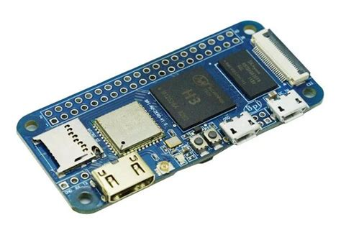
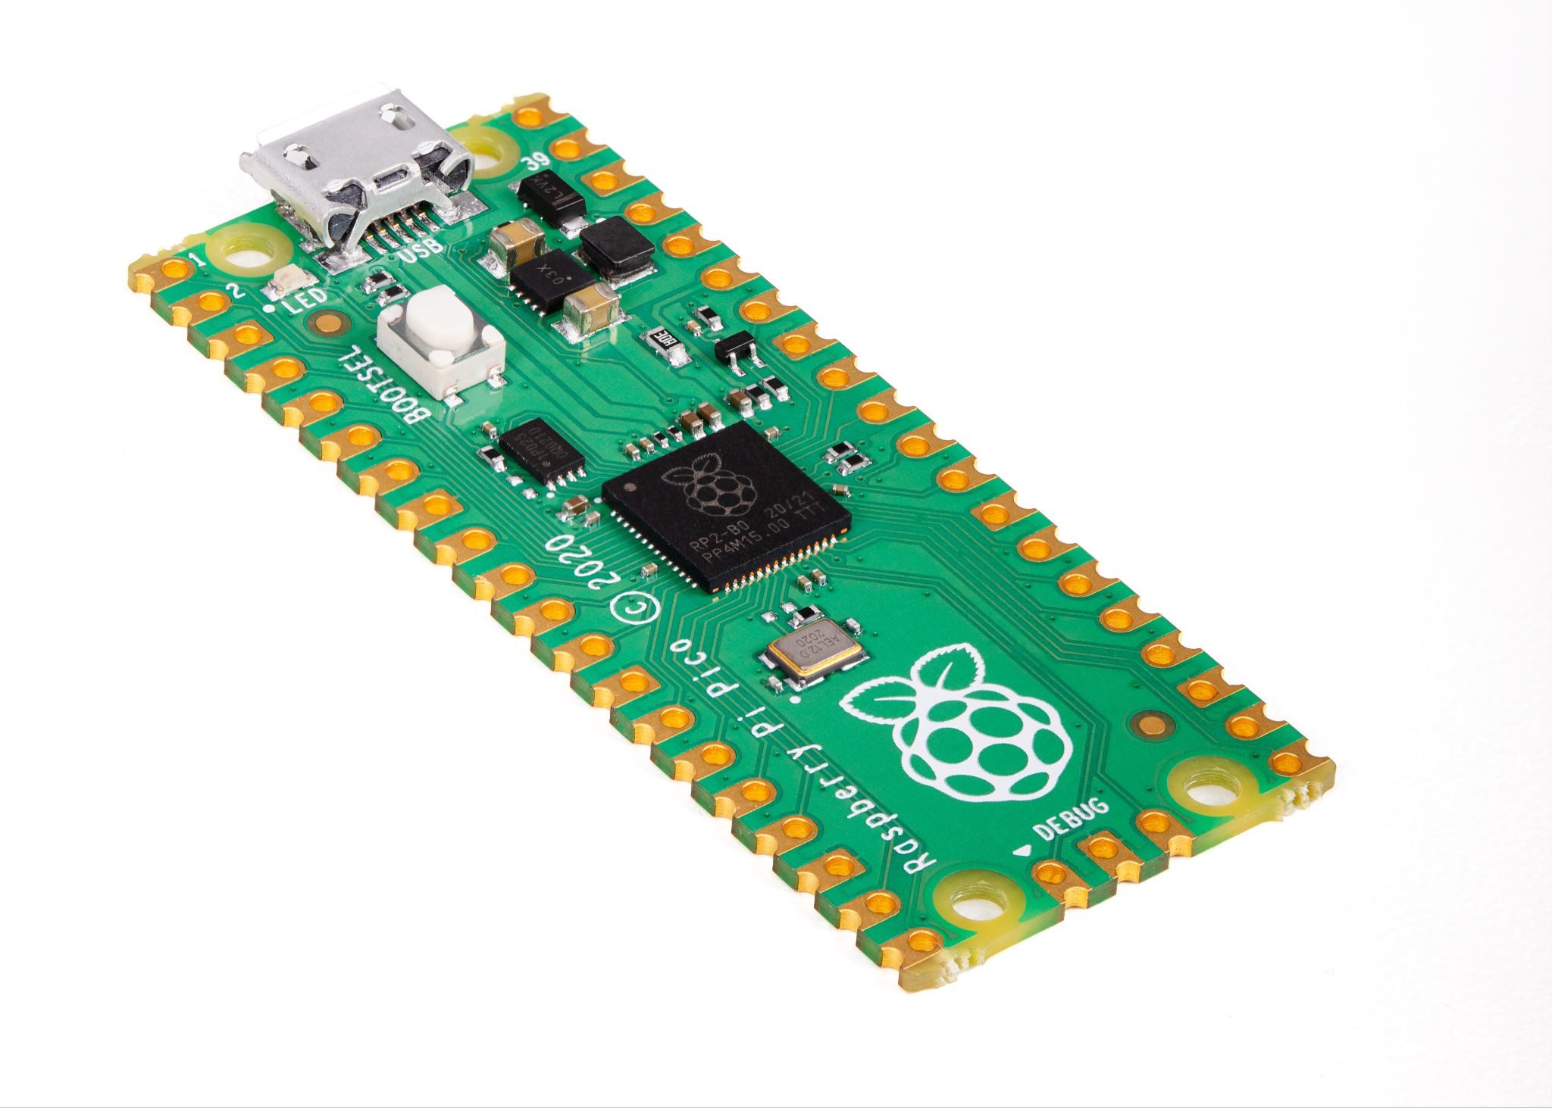
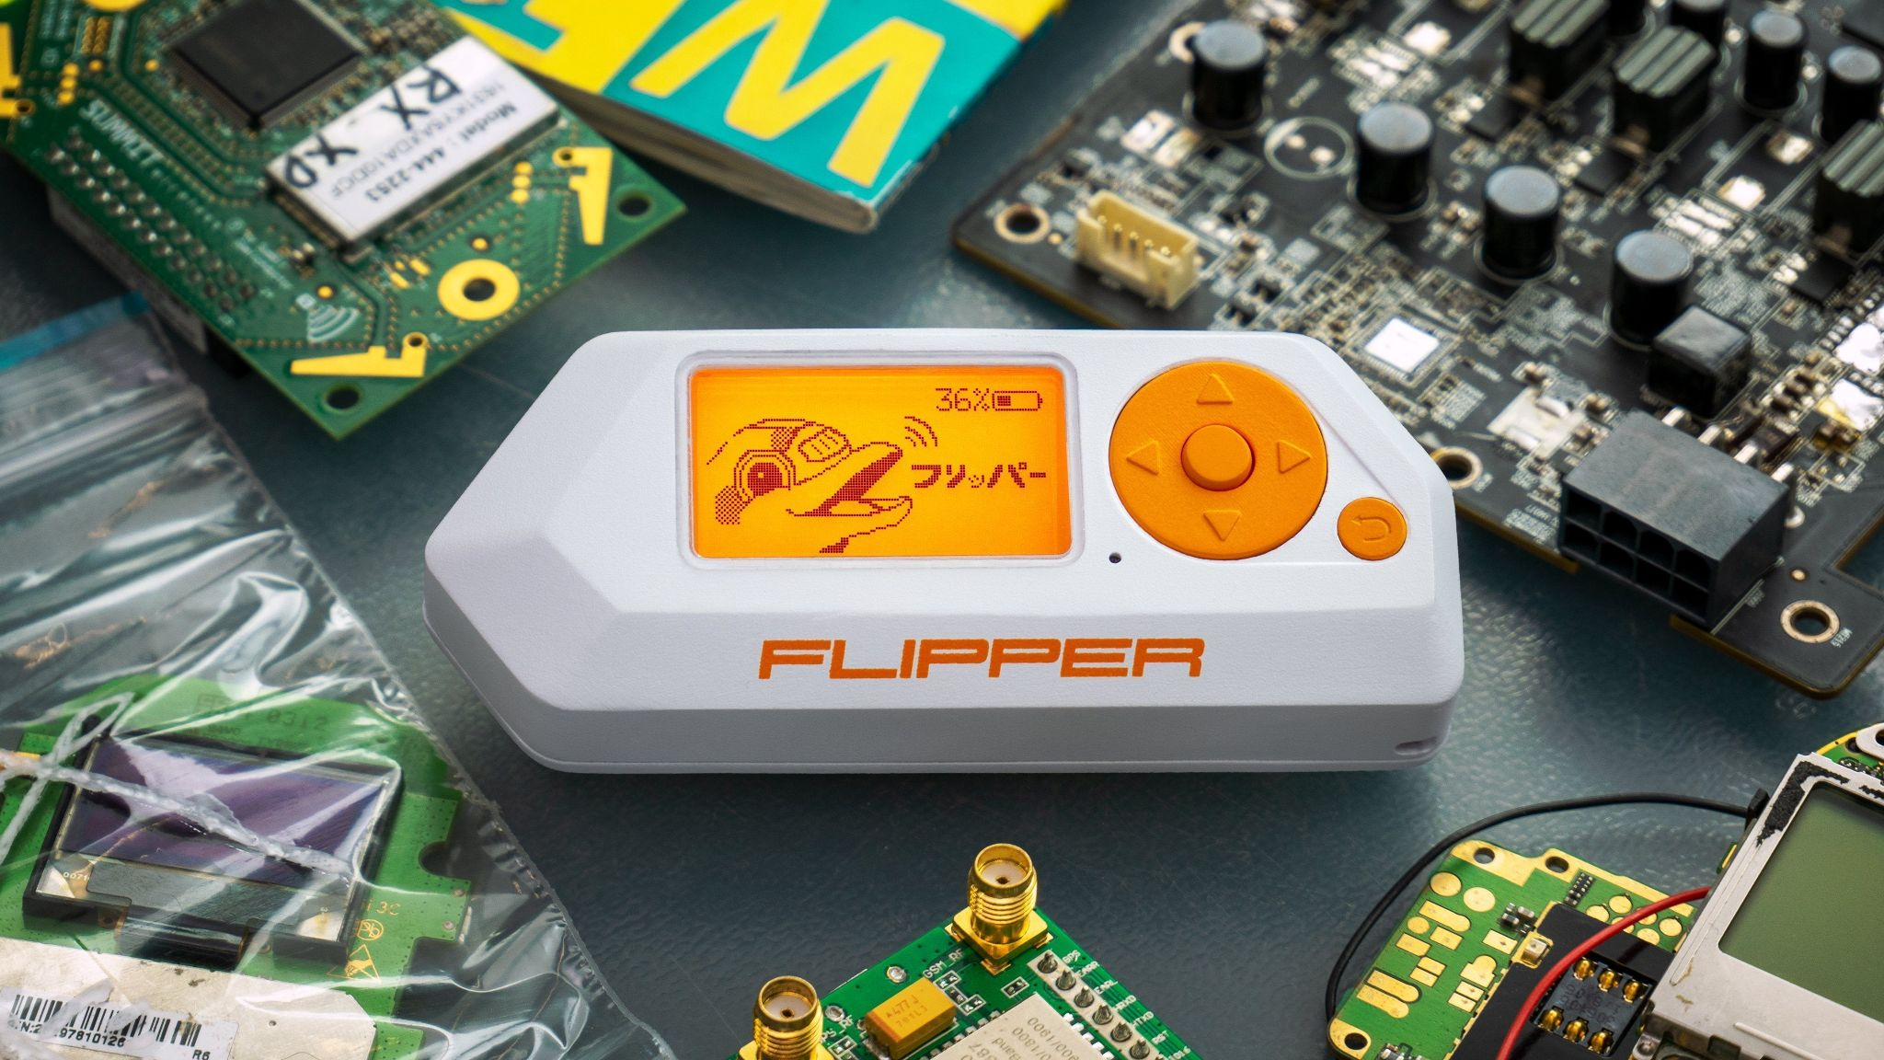
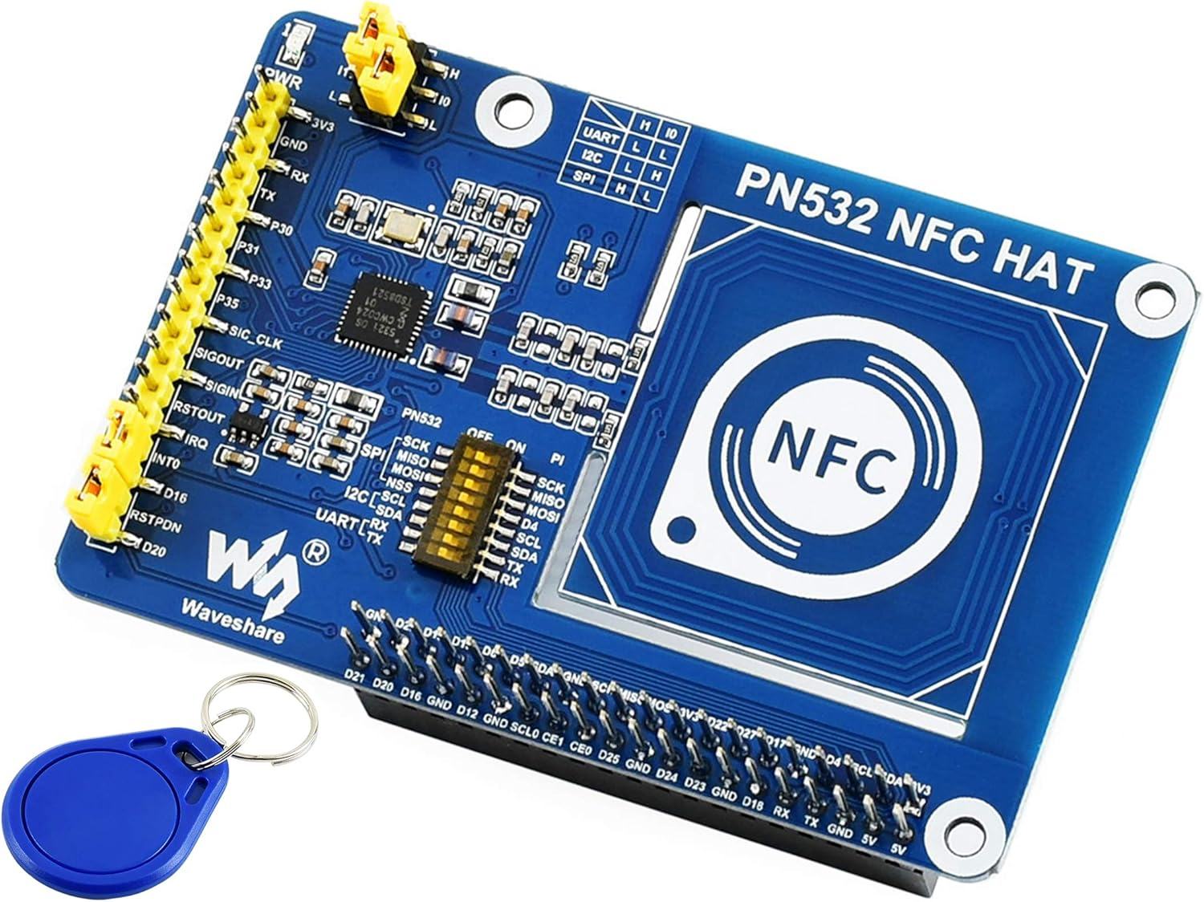
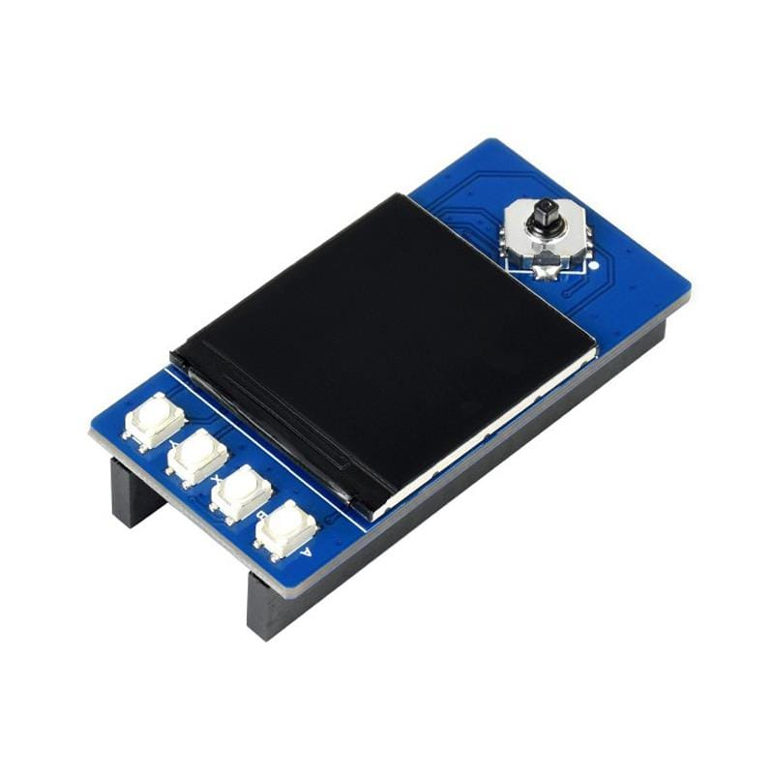
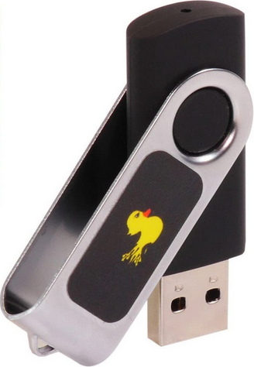
Pen-testing Multi-Tool
Adam Fitzpatrick - SETU Carlow - 17/10/24
What is it?
This pen-testing multi-tool will be a device similar to a Flipper Zero or Pwnagotchi, containing a variety of tools for pen-testing.
These multi-tools are an essential part of any offensive security team’s kit, providing a variety of different features to help assist when testing a company’s security.
The multi-tool will be pocket-sized, allowing for easy transportation and will have a built in display with buttons for menu navigation.
Target Audience
The multi-tool will mainly target ethical hackers, pen-testers and red-teamers namely. These are people who are involved extensively in offensive security.
The multi-tool will allow got these pen-testers to test systems and for red teamers to test physical defenses and response capabilities.
What will be its core features?
WiFi packet capture & man in the middle (MITM) attacks.
Bluetooth data capture & pairing
NFC/RFID scanning and emulation
Infrared signal emulation
Rubber Ducking
References
https://flipperzero.one/
https://www.pi-shop.ch/raspberry-pi-pico
https://thepihut.com/products/1-3-ips-lcd-display-module-for-raspberry-pi-pico-240x240
https://www.desertcart.ae/products/48012896-usb-rubber-ducky
https://thepihut.com/products/nfc-hat-for-raspberry-pi-pn532
https://wiki.banana-pi.org/Banana_Pi_BPI-M2_ZERO
How could it be made?
The main frame for the multi-tool will be built on top of a development board, this could be a Raspberry Pi, Arduino, Banana Pi or another similar device.
On top of this the device will also need different modules such as a NFC/RFID hat, an infrared emitter / reader and Wi-Fi and Bluetooth modules.
The device will also need a screen and buttons for menu navigation.
What technologies could be supported?
WiFi
Bluetooth
NFC
RFID
Infrared
I/O (Rubber Ducking)

